Slide 1
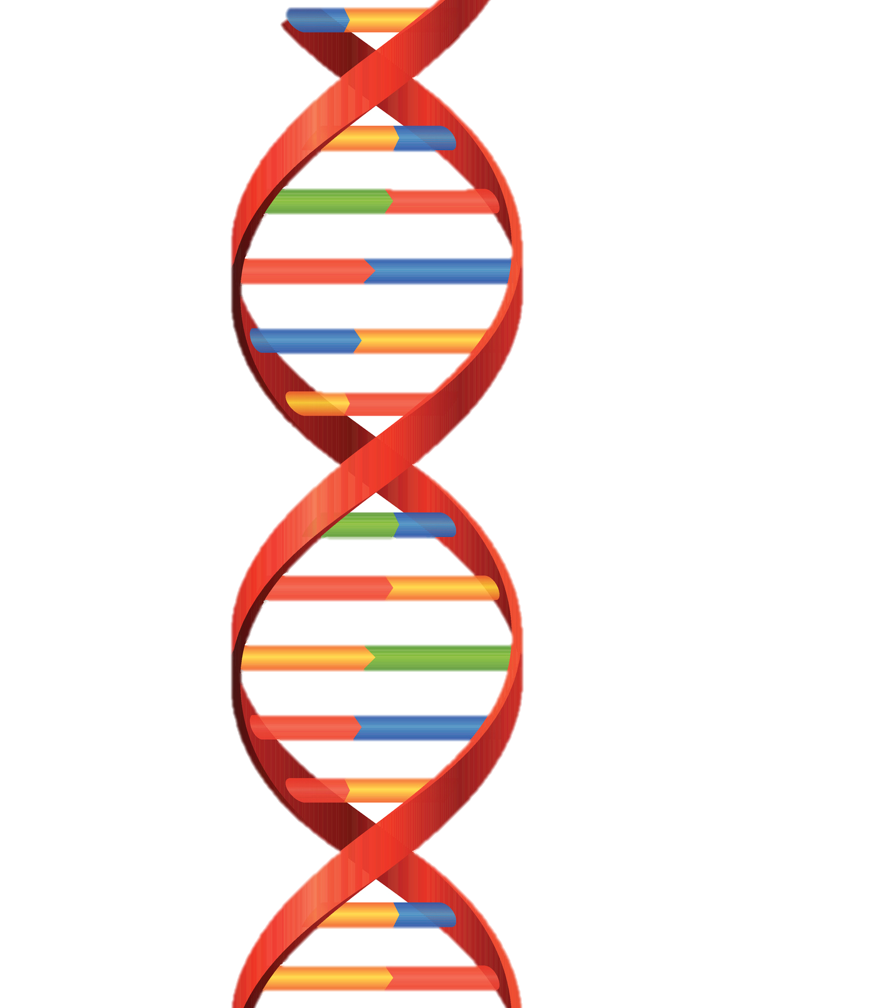
Utilizing Your Autosomal DNA to its Fullest Potential
Finding Cousins
Breaking Down Brickwalls

Slide 2
How do I download my raw DNA?
Different companies have different processes. Just google your company and find the instructions.
https://support.ancestry.com/s/article/Requesting-a-Download-of-Your-Account-Data
https://customercare.23andme.com/hc/en-us/articles/212196868-Accessing-Your-Raw-Genetic-Data
https://faq.myheritage.com/en/article/how-do-i-download-my-raw-dna-data-file-from-myheritage
https://learn.familytreedna.com/autosomal-ancestry/universal-dna-matching/may-download-family-finder-raw-data/

Slide 3
Now What Do I Do with the Raw DNA?
Upload to:
FtDNA,
Gedmatch,
My Heritage
All are free, but a one-time small fee if you want to use the tools.

Slide 4
How Do I Use DNA Shared Matches?
Shared Matches & Through Lines
Shared DNA Matches & Theory of Family Relativity
Paternal or Maternal
& In Common/Not in Common

Slide 5
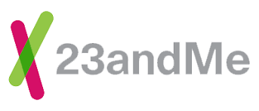
Find Relatives in Common & Family Tree
One to Many or One to One

Slide 6
Other Online Tools…
Family Search
Wiki Tree
YouTube videos
Website help videos

Slide 7
DNA Painter

Slide 8
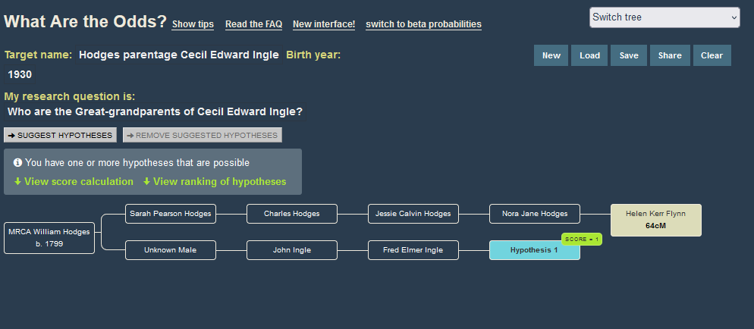
WATO?

Slide 9
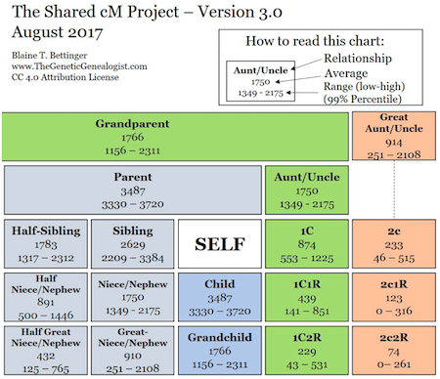
Shared Centimorgan Project

Slide 10
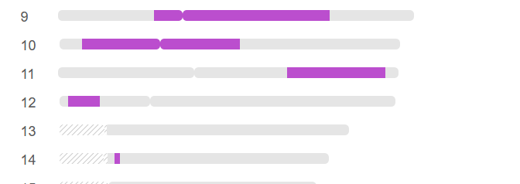
Chromosome Browser

Slide 11
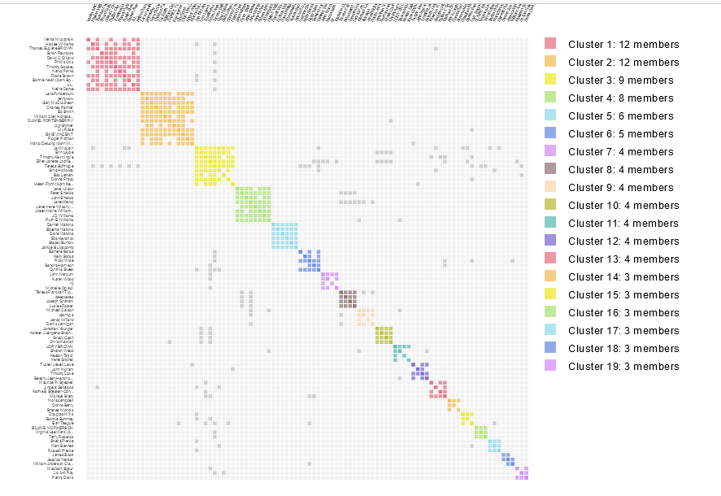
Chromosome Maps

Slide 12
How to Search for Contemporary Matches
Build their tree yourself
Google is your friend!
Online obituaries and Find A Grave
My Life, ClustrMaps, Peoplefinder, Radaris
Social Media: FaceBook, Twitter, LinkedIn

Slide 13
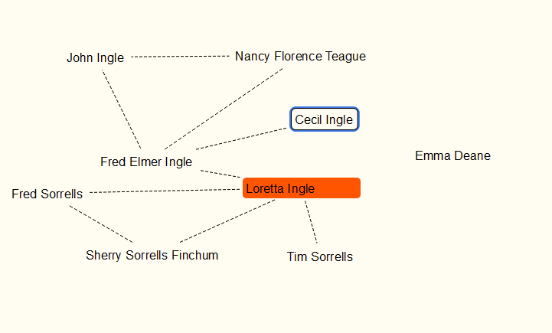
Another Tool…
Scapple ($18 software fee)

Slide 14
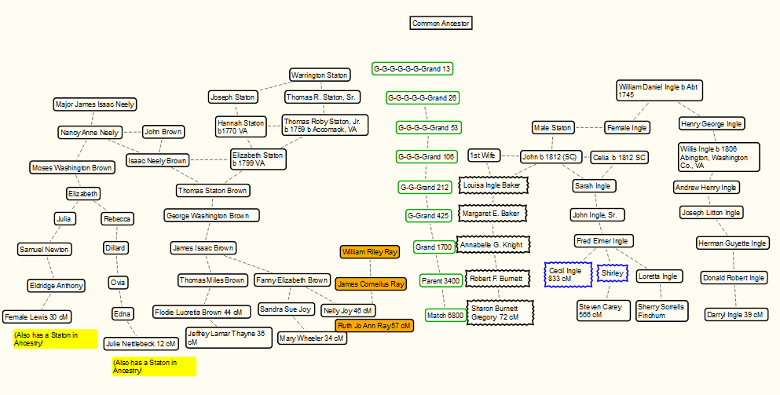

Slide 15
Additional Resources
Genetic Affairs creates chromosome maps
Living DNA (International)
Geneanet

