Slide 1

WHITAKER
From the Holme to Pleasant Garden

Slide 2
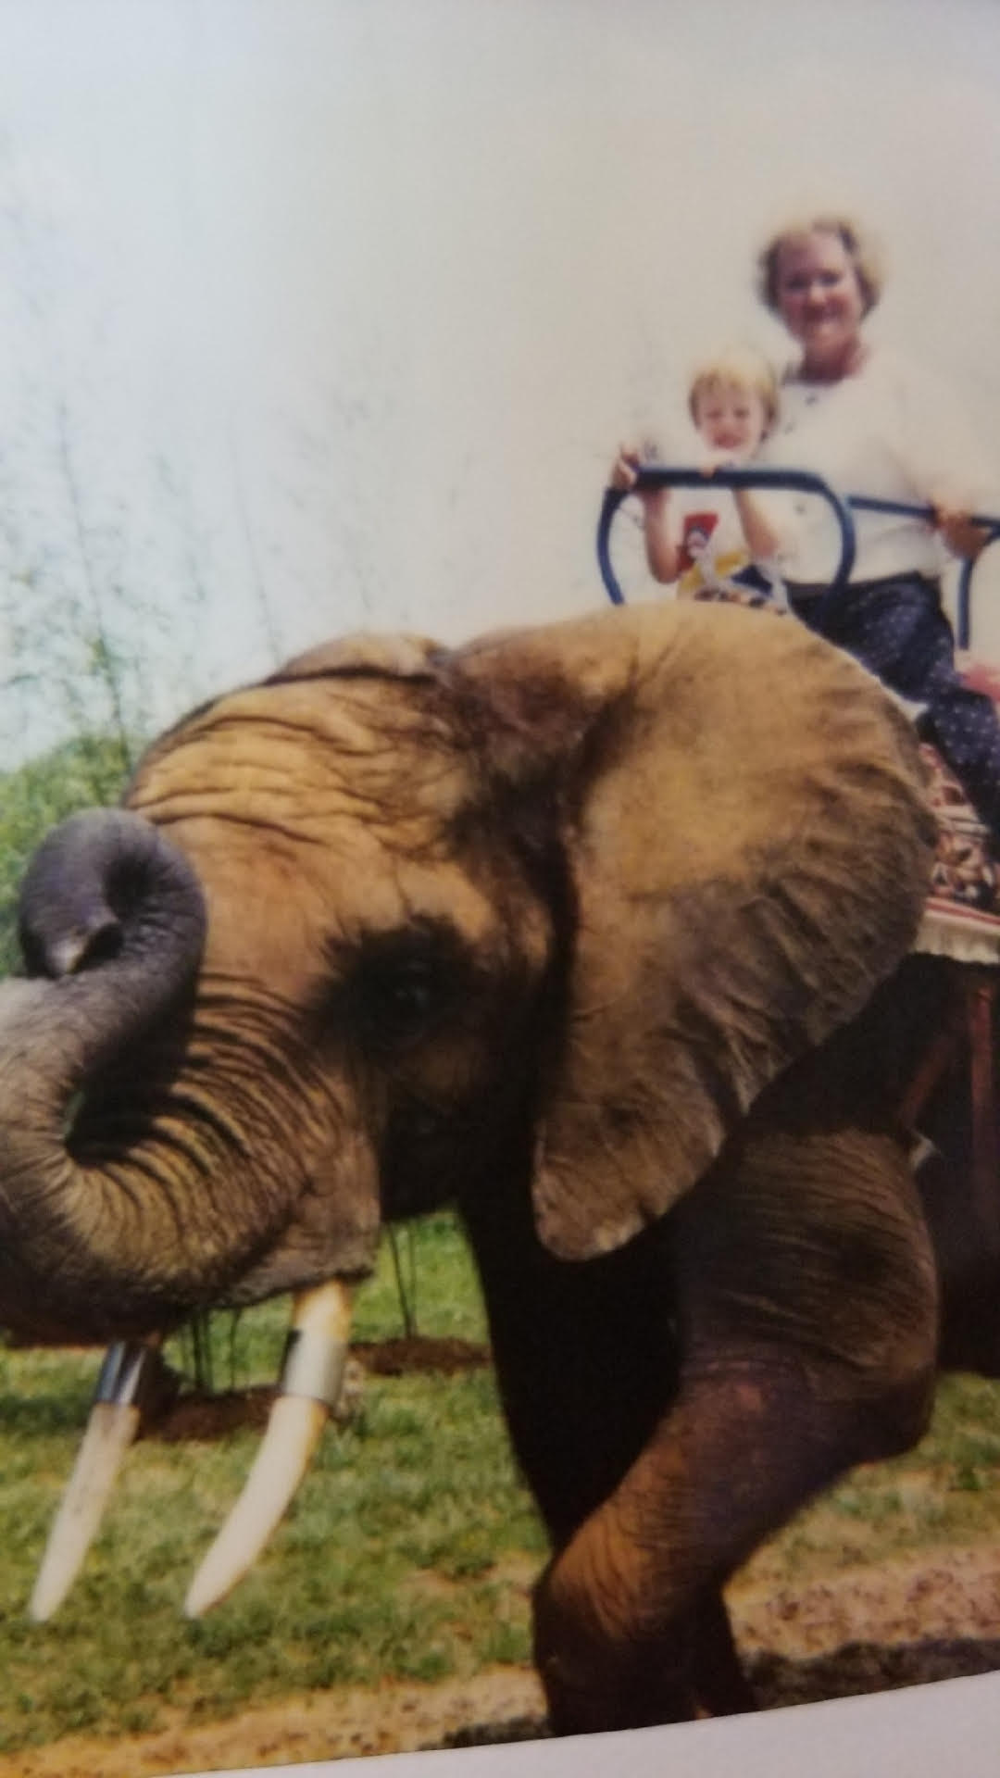
Correspondence Genealogy and How Little We Knew
The Blue Book

Slide 3

Brief History in England
The Holme
Clitheroe Castle and Feudalism
English Social Classes
Descent of Arms

Slide 4
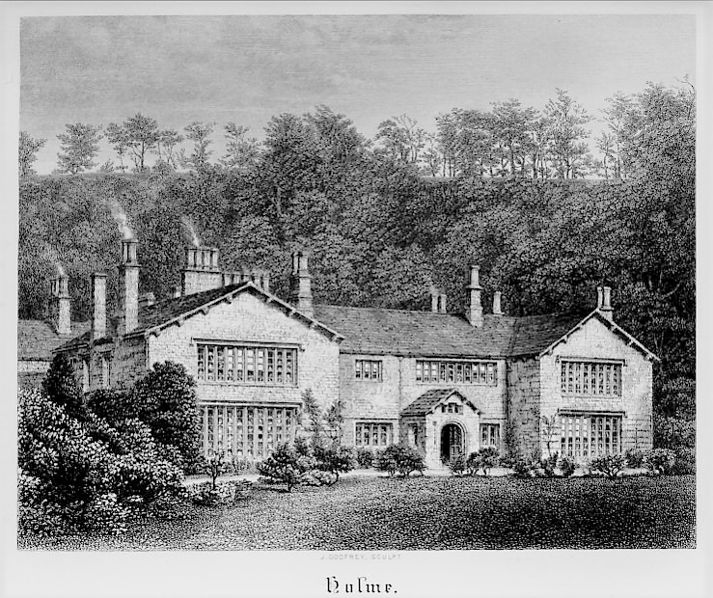

Slide 5
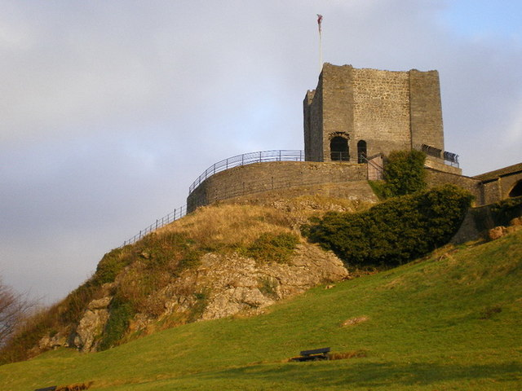
Clitheroe

Slide 6
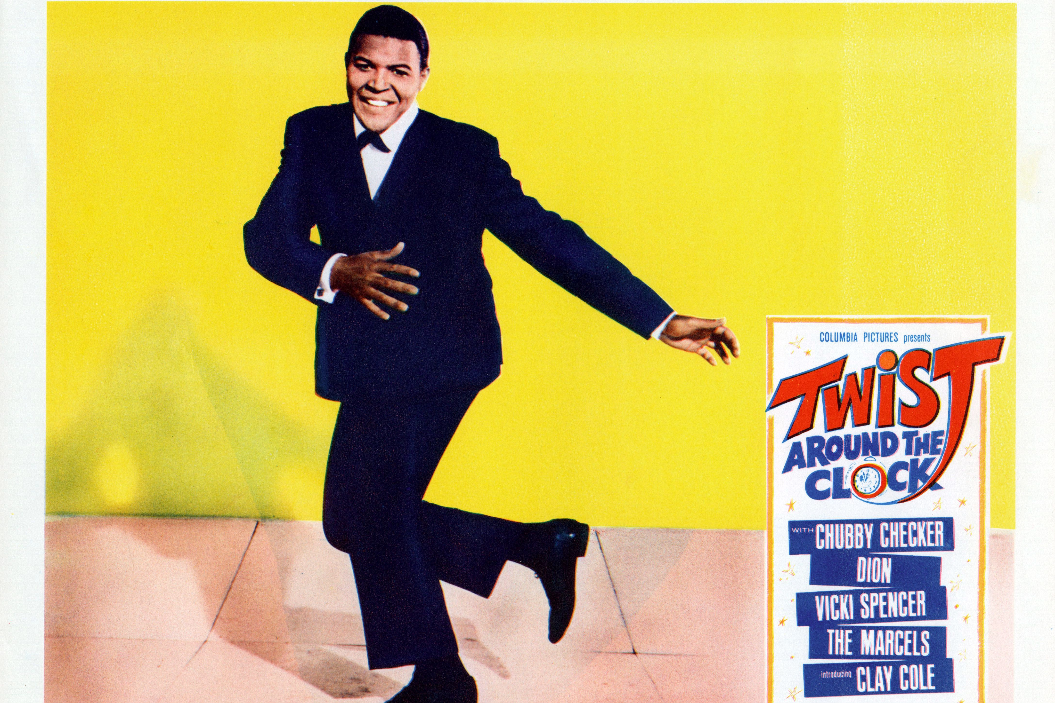
First Twist

Slide 7
Laws Concerning Heraldry
Scropes v. Grosvenor (1389)
Distinguishing and Inheriting Arms

Slide 8

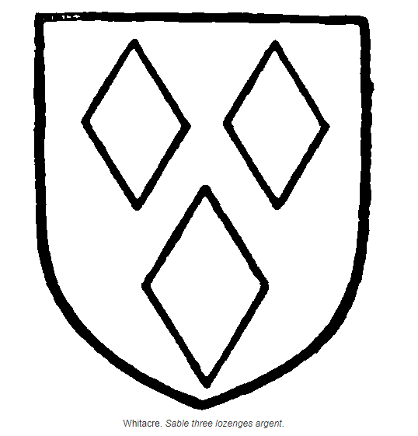
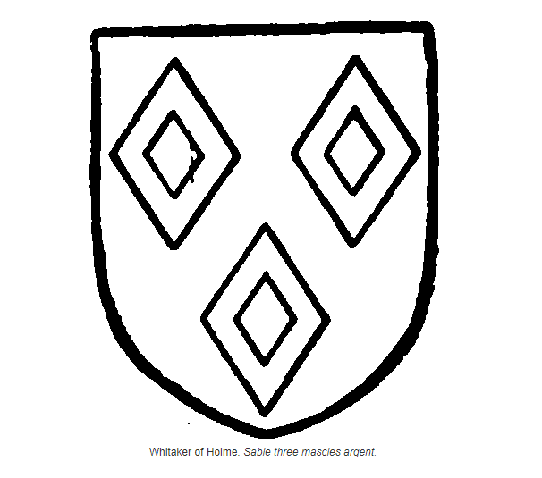
Whitacre → Whitaker

Slide 9
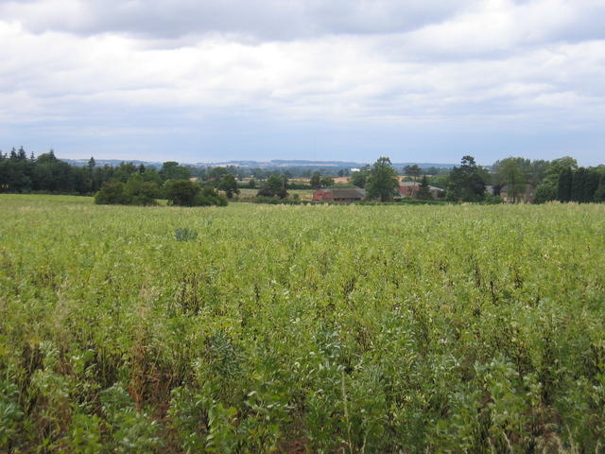
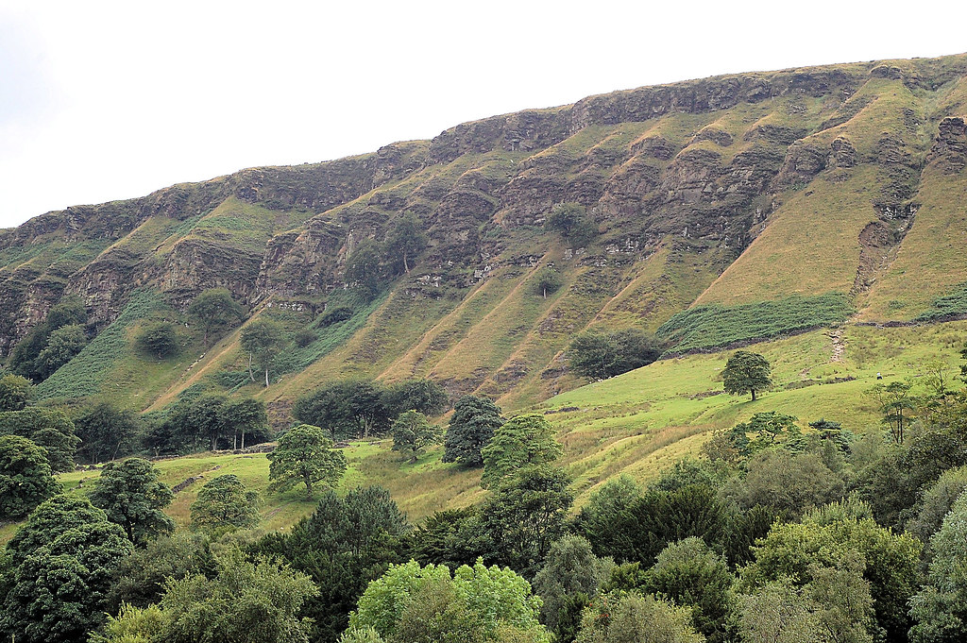
How did we get from here to here?

Slide 10
The Whitakers of Warwickshire
Originally called Barcheston – Whitacre used as the name of a junior branch
First record – Simon de Whitacre sat on seven juries during the eyre of 1232
Jordan de Whitacre and Simon de Whitacre listed as knights in the Curia Regis Rolls
Legal Troubles – Lordship, Knighthood, and Locality

Slide 11
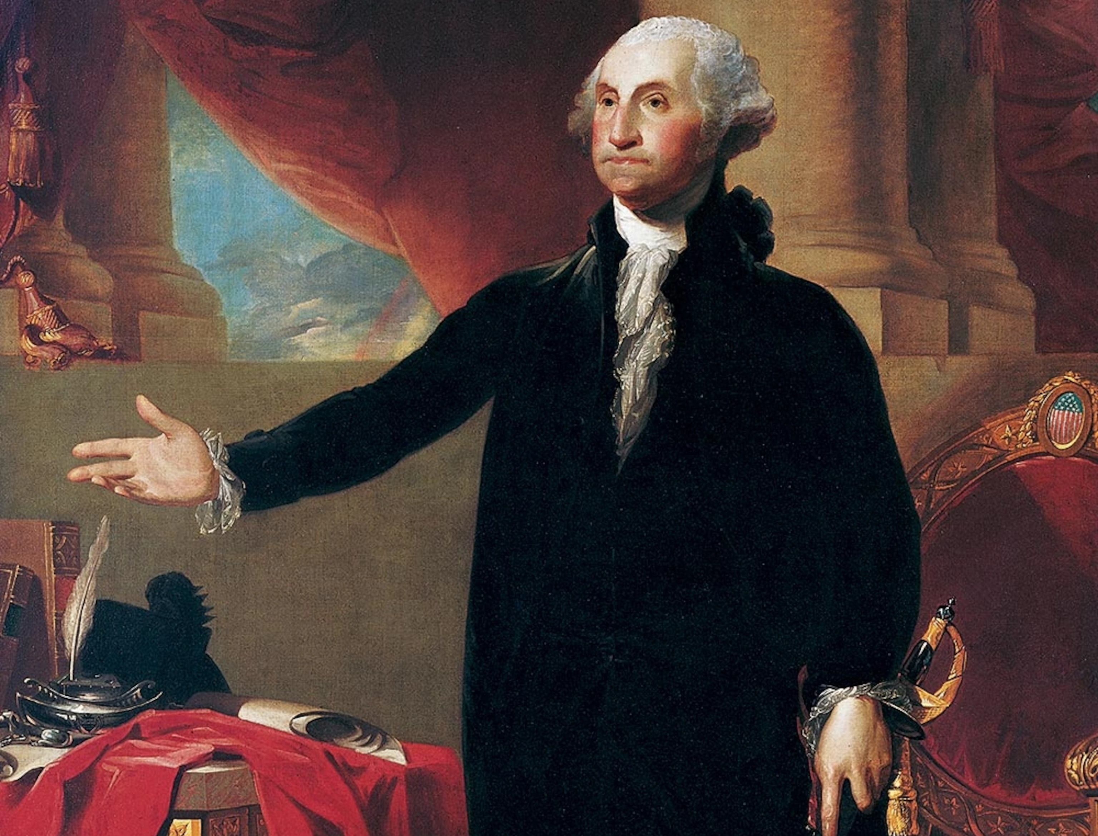
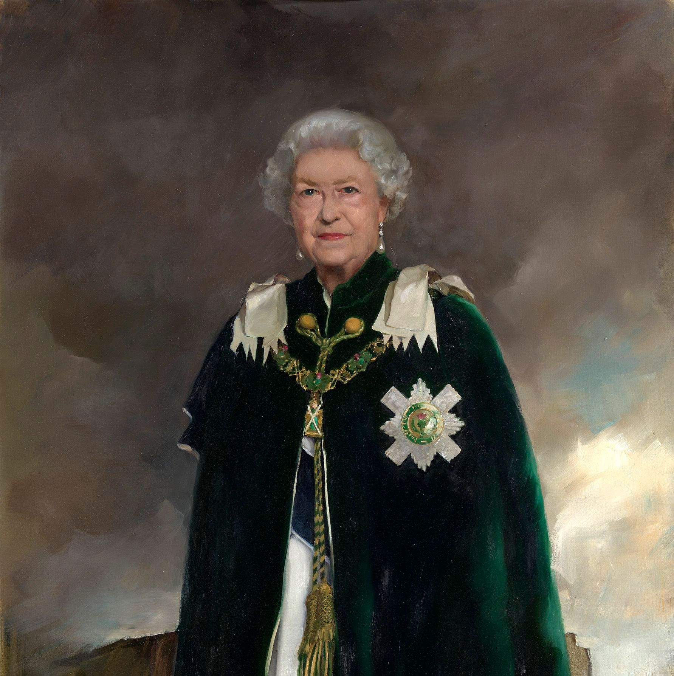
Getting From Here to Here

Slide 12

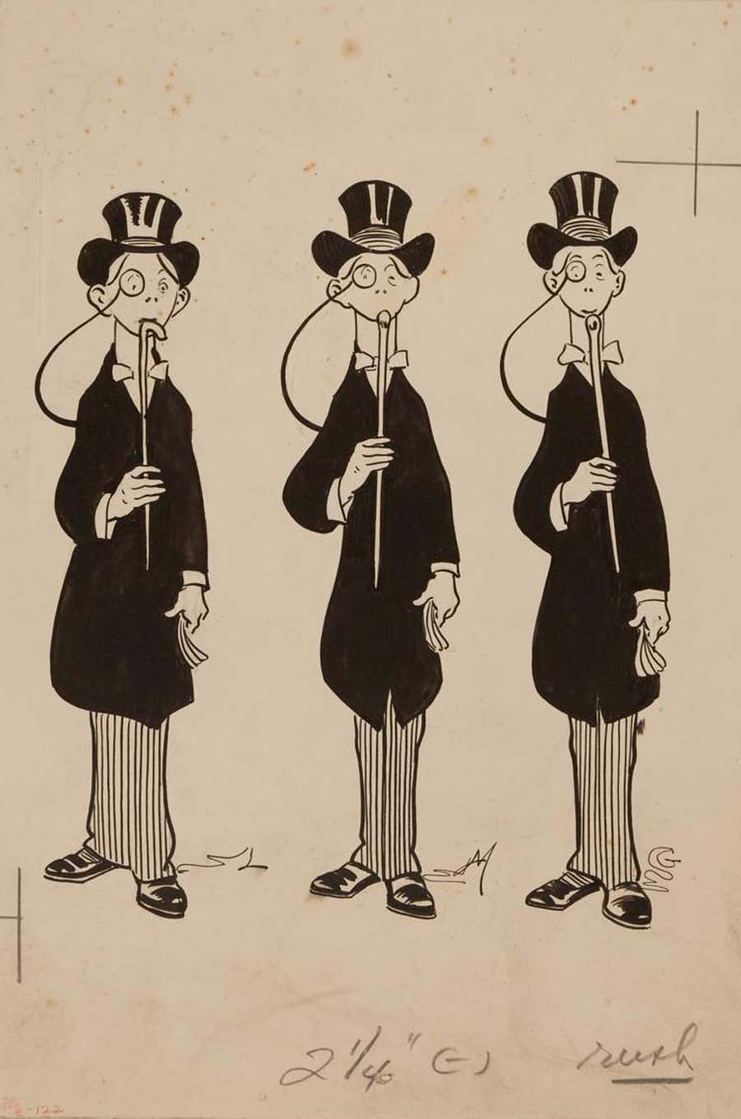
Rowan County, North Carolina and the three Mark Whitakers

Slide 13
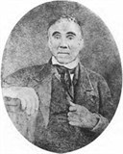
The Known Entity – John Whitaker
From Rowan County
Father was one of the Mark Whitakers
Brother named Mark
Served in the Revolution
Married Martha Wilcockson and later Nancy Guess
Settled on the east side of Mulberry Creek
John J. Whitaker (son)

Slide 14
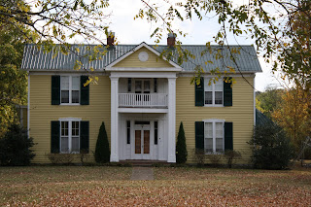
John “Peg Leg” Whitaker
Rowan County, NC
The Revolution – Fighting in the Salisbury District
Kentucky
Lincoln County and Mulberry, TN

Slide 15
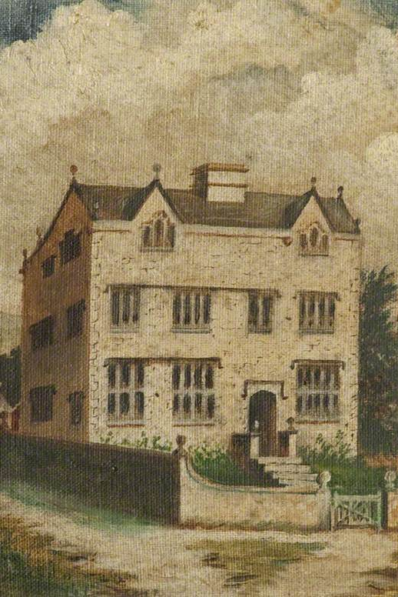
The First Line
Joshua Whitaker and Jane Banister Parker Whitaker

Slide 16
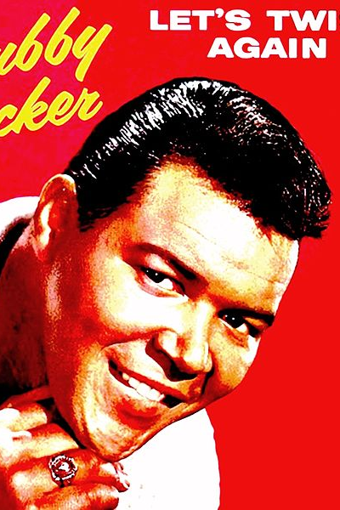
Second Twist

Slide 17
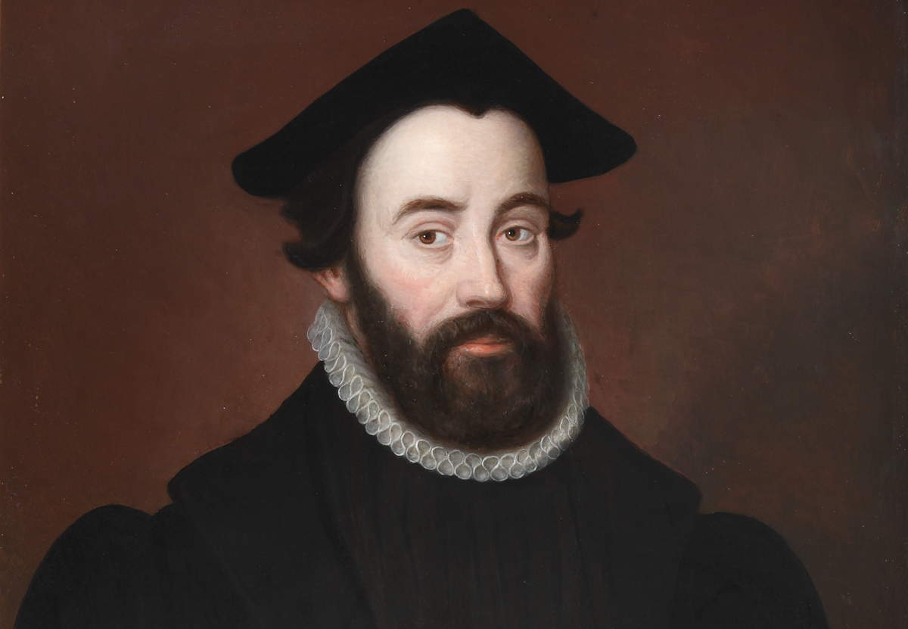
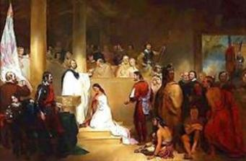
The Second (Really First) Line
Jamestown, 1620

Slide 18
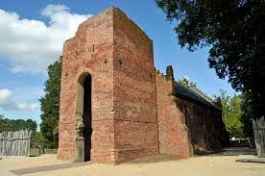
Pennsylvania versus Jamestown
Descendants of Jabez
The two “John Whitakers”
The Conflicting Primary Source

Slide 19
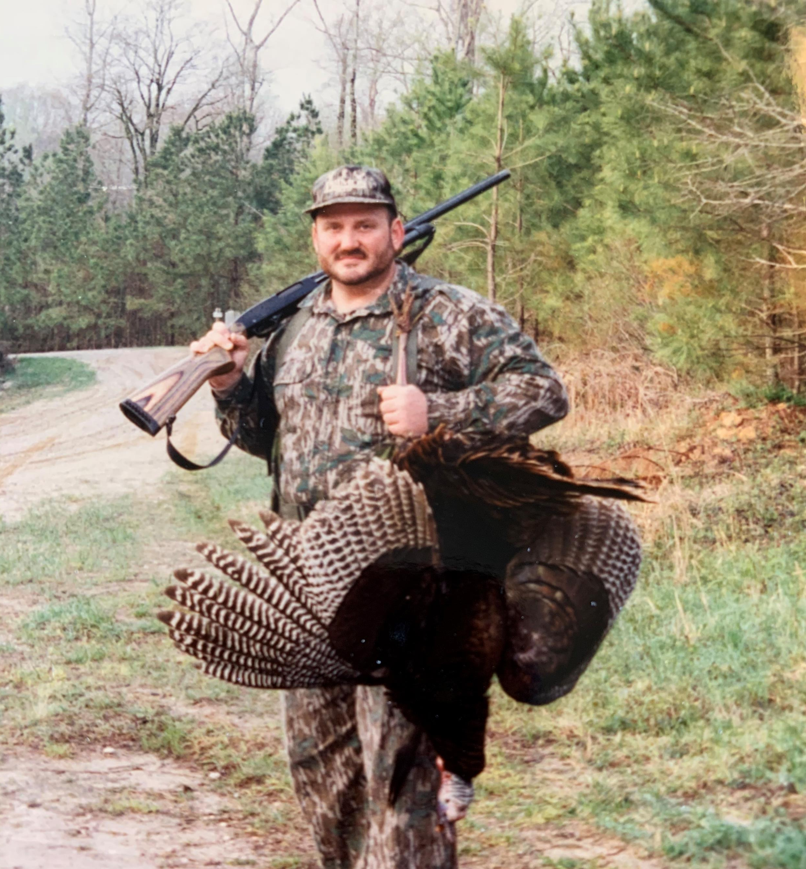
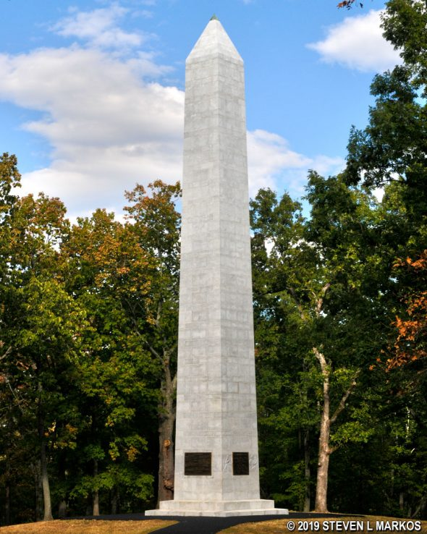
Dad’s Discovery

Slide 20
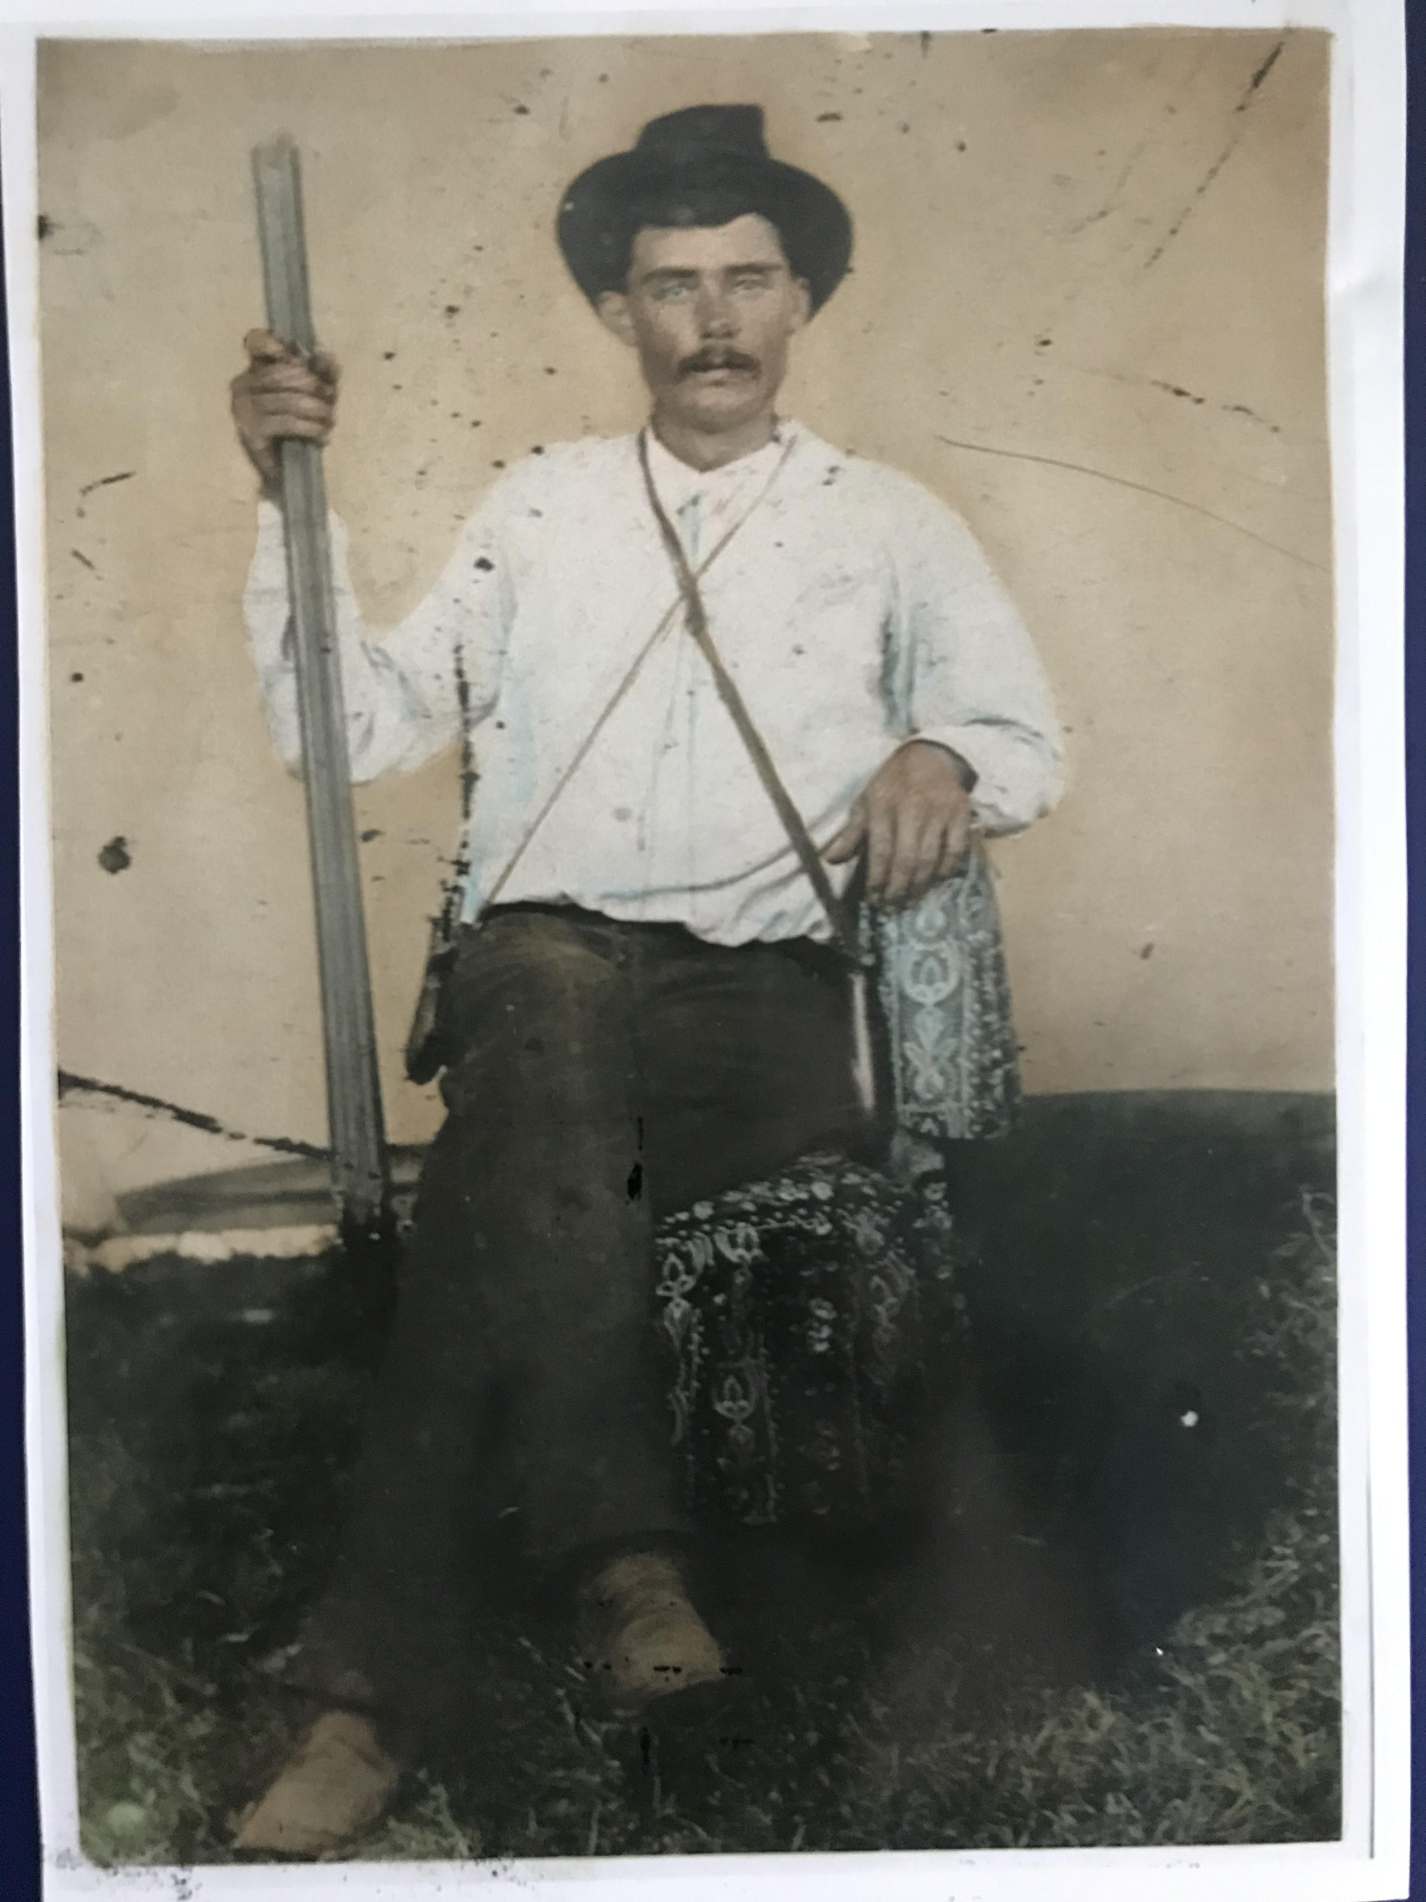

Slide 21
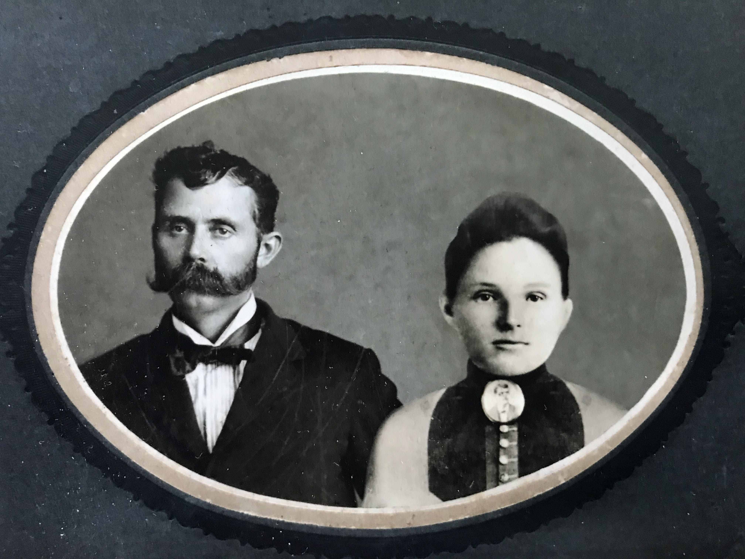

Slide 22

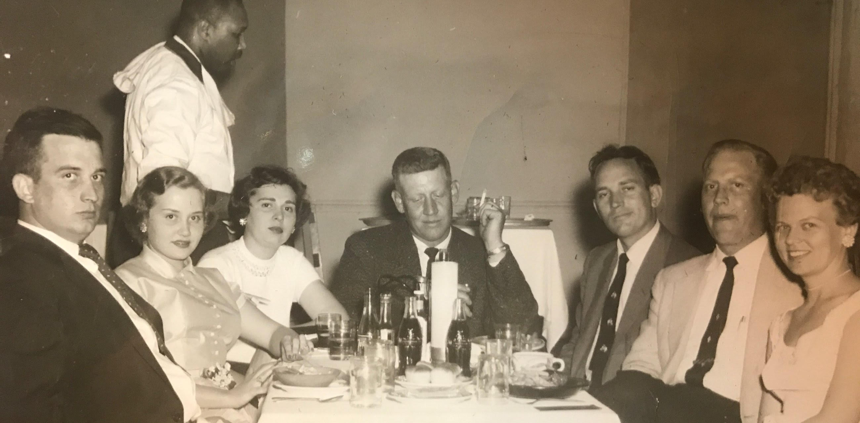

Slide 23
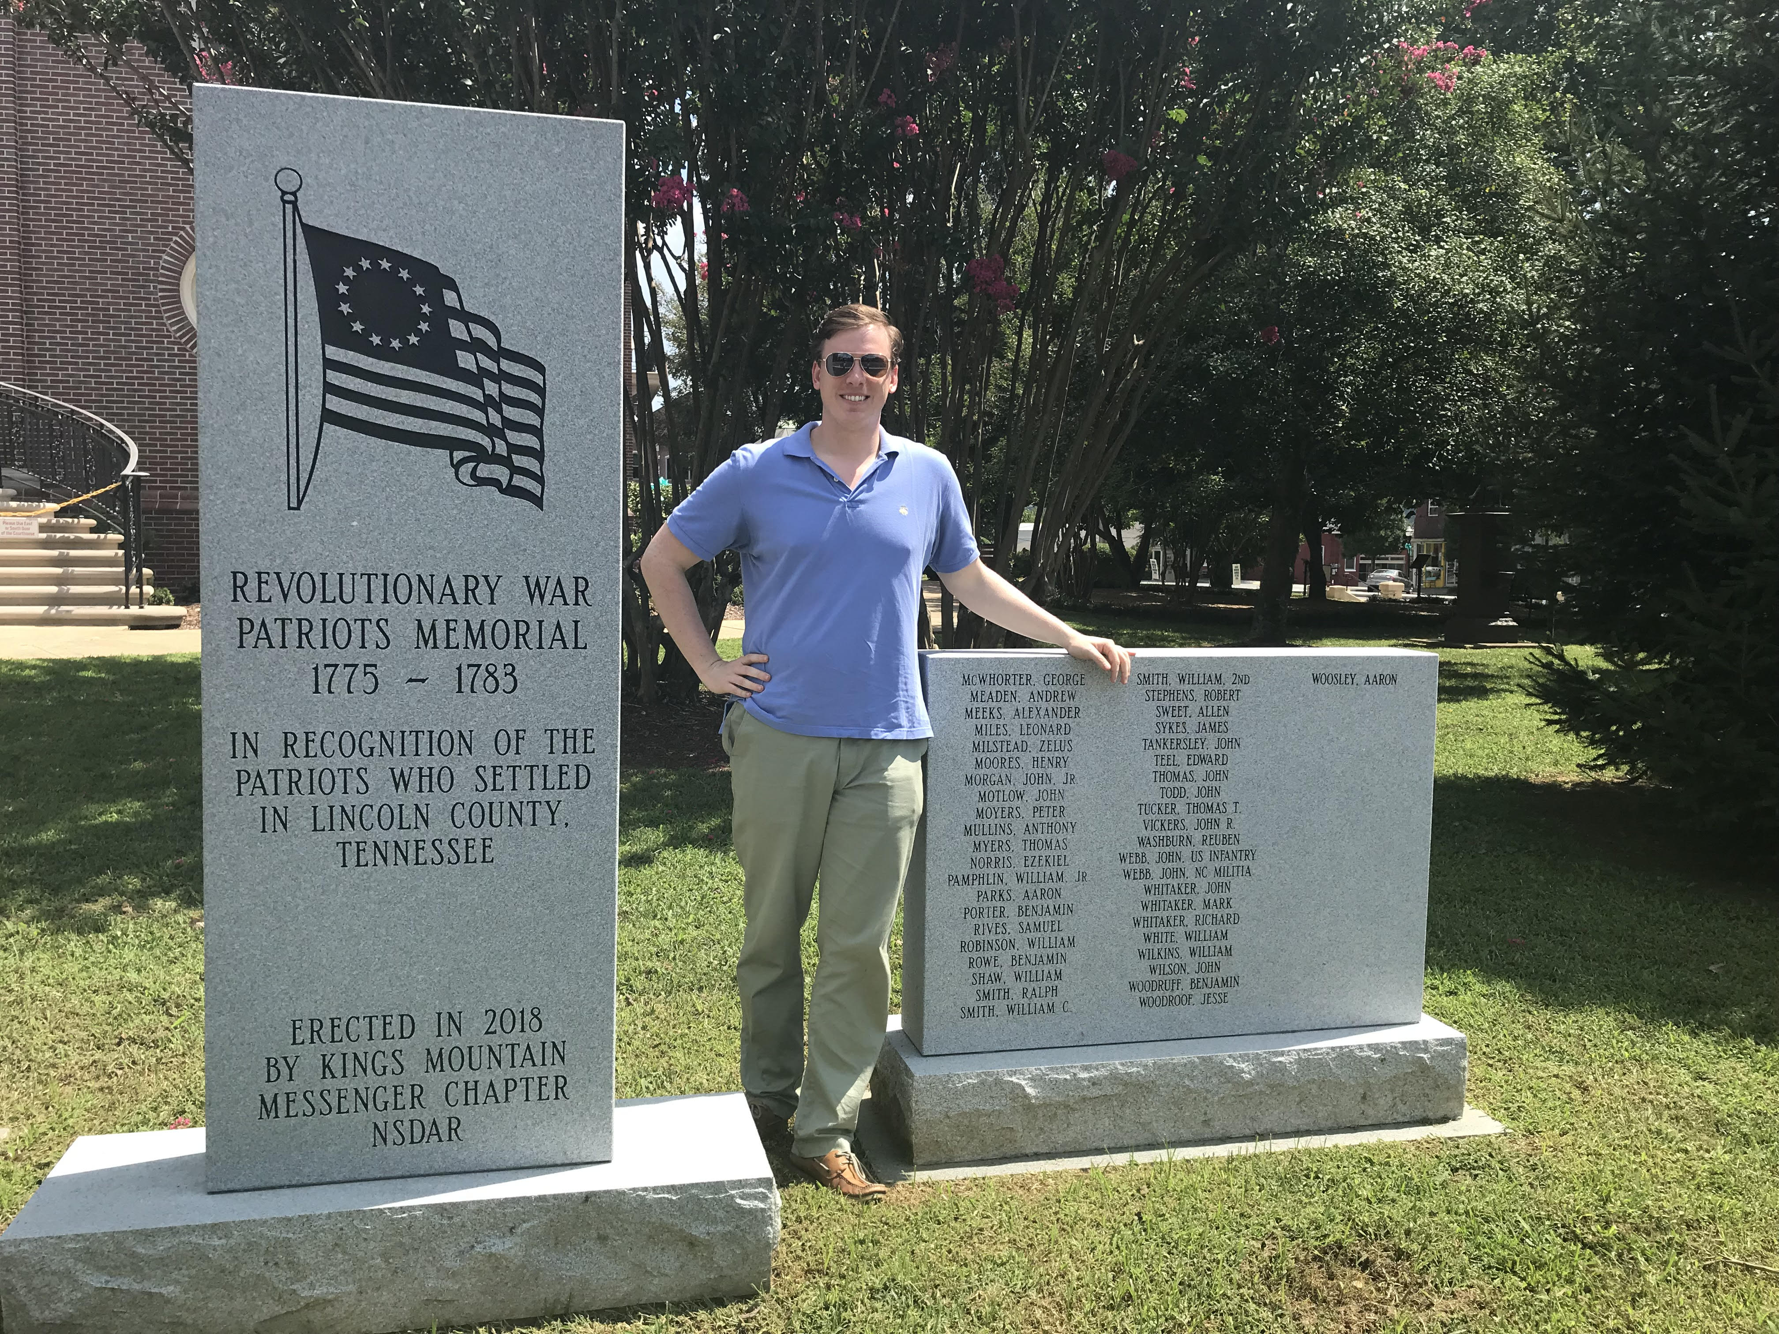

Slide 24
